Slide 1
Professional Picks
Luke McMaster
Team Leader
Children’s & Young Adult Services
Waverley Library

Slide 2
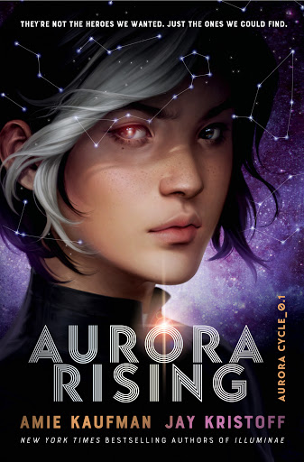
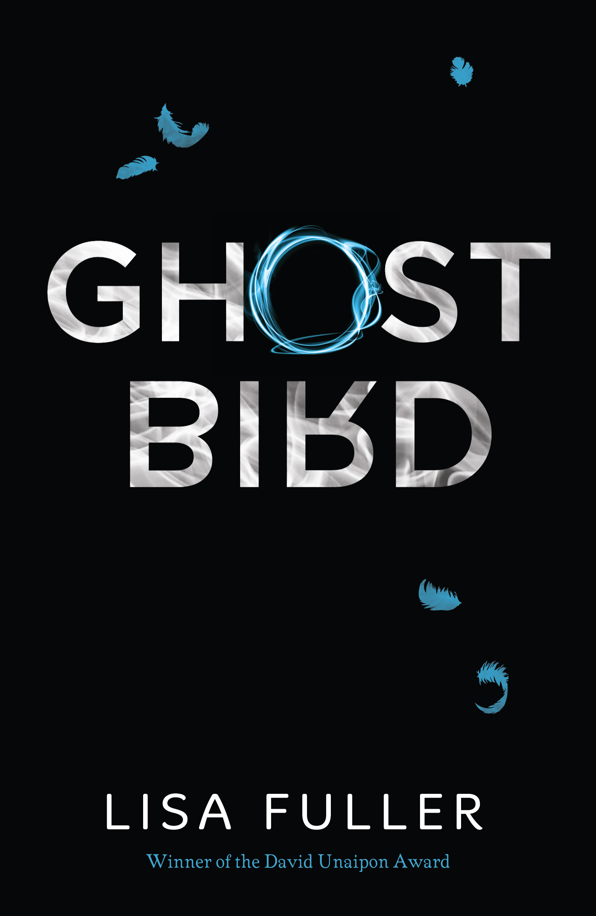
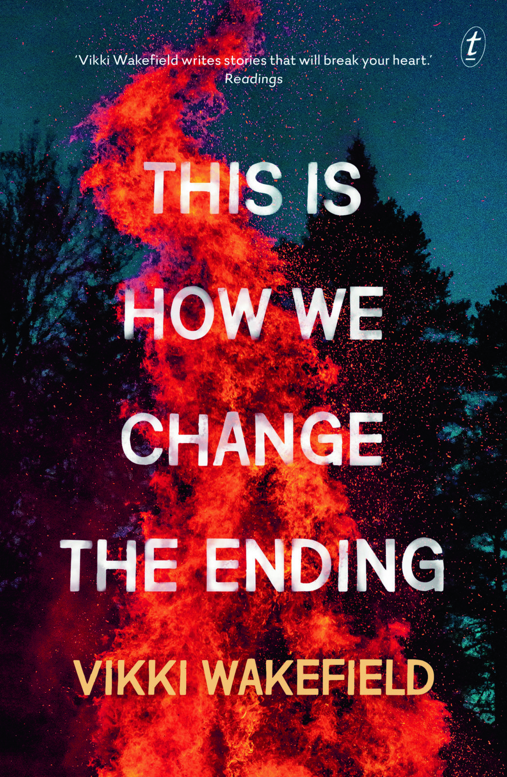
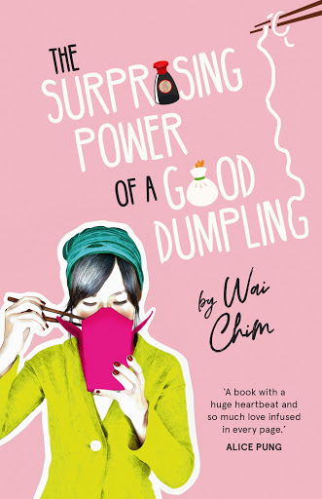
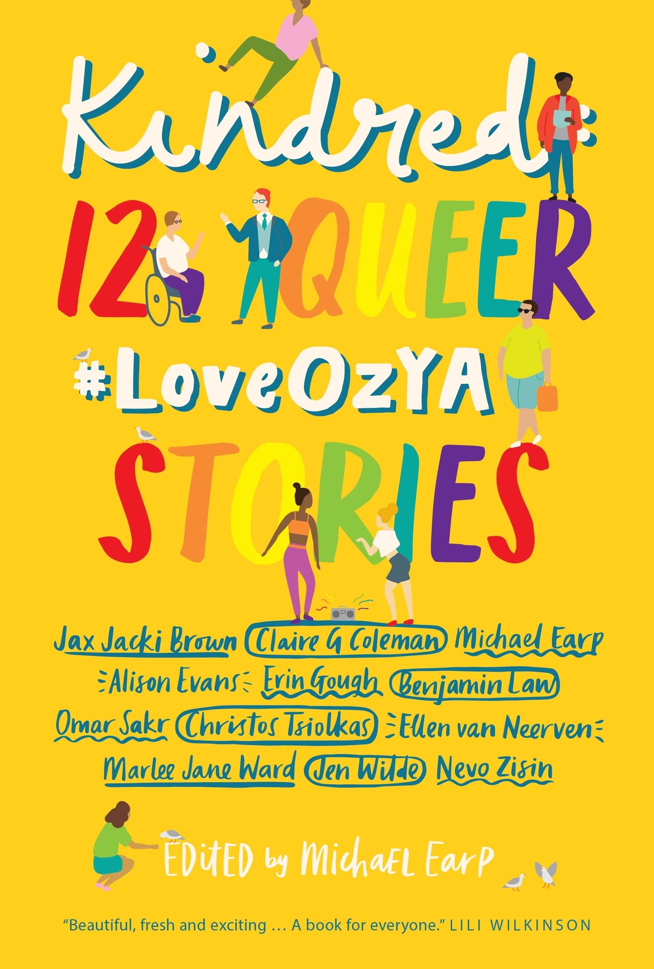
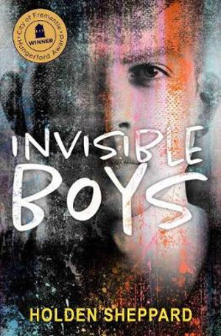
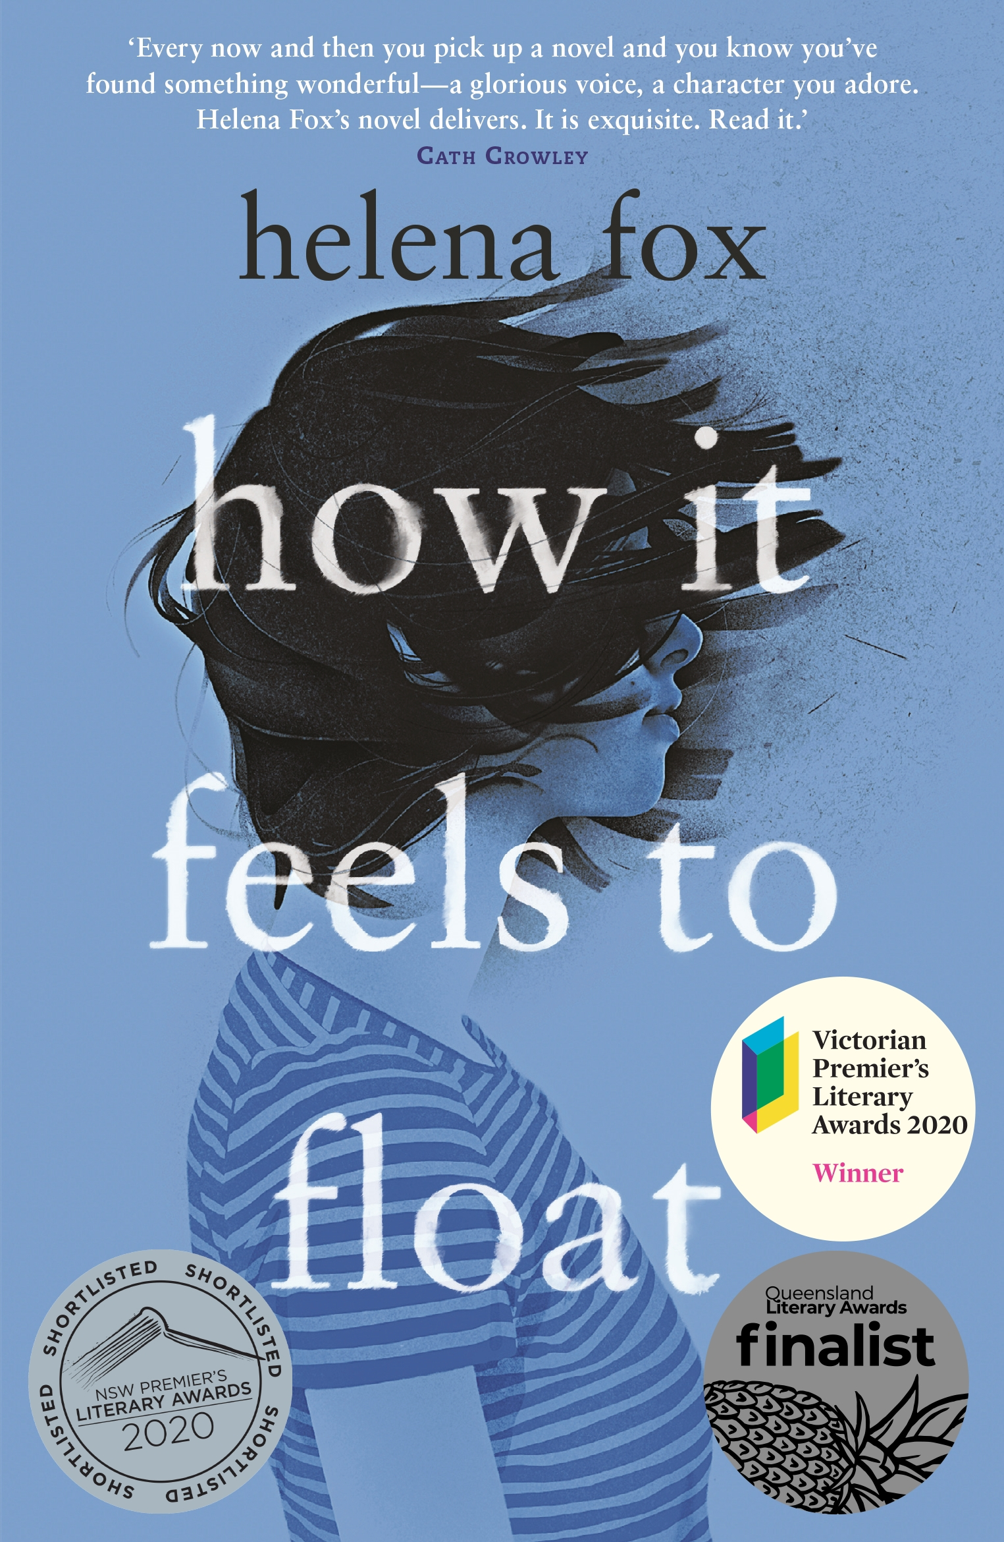
Older Readers
Top Picks of 2019

Slide 3
Ghost Bird Lisa Fuller

Slide 4
This is a unique and suspenseful, atmospheric page turner that taps in to the terrors hiding in the shadows.

Slide 5
This is How We Change the Ending Vikki Wakefield

Slide 6
Beautifully written with powerfully rendered characters struggling to find their place in a world where the odds are stacked against them.

Slide 7
Aurora Rising Amie Kaufman & Jay Kristoff

Slide 8
Overall, a refreshing sci-fi thriller with clever, smart mouthed dialogue. Highly enjoyable.

Slide 9
Invisible Boys Holden Sheppard

Slide 10
There are moments of triumph and complete heartbreak found in this book. Most importantly, there is a lesson for everyone to truly embrace difference to give those invisible boys out there the opportunity to be who they truly are.

Slide 11
How It Feels To Float Helena Fox

Slide 12
A beautiful and ultimately hopeful story of living with mental illness.

Slide 13
The Surprising Power of a Good Dumpling Wai Chim

Slide 14
Easy to read and in no nonsense terms presents a straight up portrayal of mental illness and how it touches those around us. Hopefully it leads to conversations with friends and family to talk about their mental health.

Slide 15
Kindred Edited by Michael Earp

Slide 16
Recommended as a book for young adults and adults in general. It shows a great depth of empathy, understanding and feeling that will broaden your perspective.

